Slide 1

AccelCQ Business Strategy
For investors, clients looking to invest in Generative AI, Confidential Computing and Quantum Computing
AccelCQ LLC, CA Confidential & Proprietary

Slide 2

Our Strategic Approach
🎯 Why We Exist
⚡ How We Deliver
🚀 What You Get
AccelCQ accelerates innovation by enabling enterprises to rapidly build, test, and deploy advanced AI-driven and computing solutions
Through turnkey solutions, staff augmentation, and demo-driven experiences across Azure confidential computing and IBM quantum computing
Interactive demo platform, multi-cloud workloads, and rapid development environments as your project foundation
AccelCQ LLC, CA Confidential & Proprietary

Slide 3


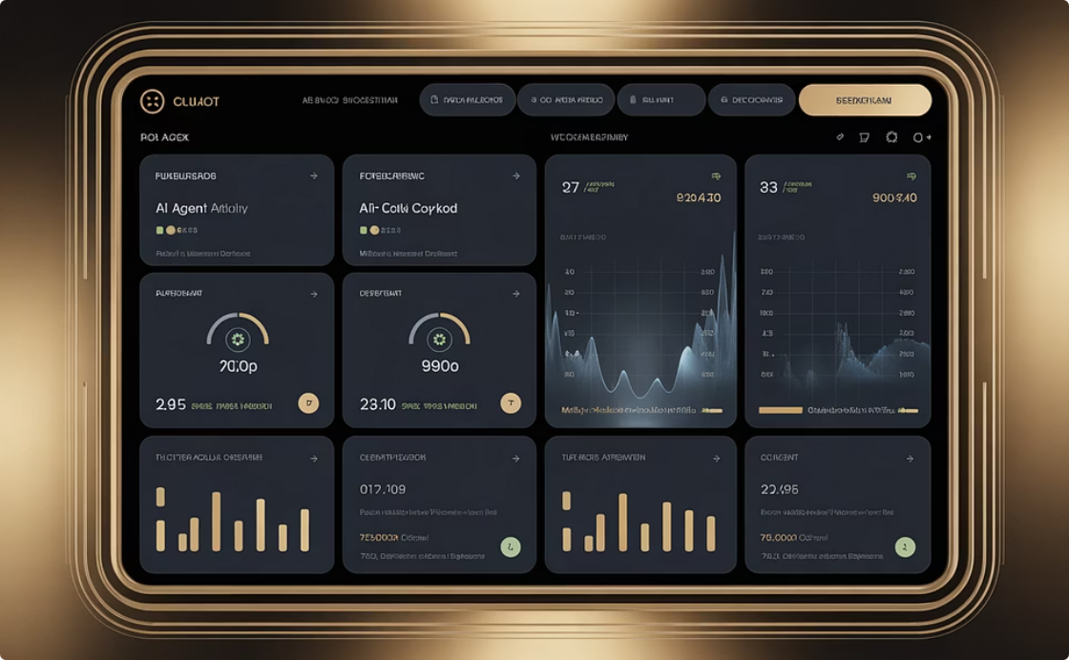
Simon Sinek's Golden Circle Strategy
🎯 WHY (Purpose)
⚡ HOW (Approach)
🚀 WHAT (Deliverables)
AccelCQ accelerates innovation by enabling large enterprises to rapidly build, test, and deploy advanced AI-driven and computing solutions. We empower clients to move from concept to deployment faster—bridging the gap between innovation and execution through rapid prototyping, confidential computing, and quantum technologies.
By providing turnkey solutions and staff augmentation with deep technical expertise, we combine CI/CD automation, API-driven integration, and AI agent capabilities. Our demo-driven approach allows clients to visualize and experience the power of rapid development in secure and scalable environments across Azure and IBM Cloud infrastructures.
Demo-enabled web platform showcasing AI agent-driven app development
Multi-cloud workload demos: Azure confidential computing and IBM quantum computing
Rapid development environment and codebase as a client reference to start new projects
AccelCQ LLC, CA Confidential & Proprietary

Slide 4





STARR Method Framework Strategy
Action
Task
Developing a CI/CD web app with AI agents, API workloads, and secure cloud deployments, showcasing accelerated innovation.
Situation
Simplify tech adoption by building an interactive demo platform for AI-driven rapid app development on secure multi-cloud.
Enterprises struggle with complexity, security, and skill gaps in adopting confidential & quantum computing.
Reflection
Result
Reinforces AccelCQ as a thought leader in confidential & quantum computing, building trust through demonstrable expertise.
Clients gain tangible PoCs & reusable architectures, reducing time-to-market and boosting tech adoption confidence.
AccelCQ LLC, CA Confidential & Proprietary

Slide 5




SCQA Framework Strategy
Complication
Situation
Clients need practical, rapid application without heavy upfront investment or long development cycles.
AccelCQ is expanding into cutting-edge domains like confidential and quantum computing.
Answer
Question
By building a demo-based web platform that uses AI-driven agents and multi-cloud integration for rapid development, security, and scalability. This is a gateway for clients to begin their innovation journey.
How can AccelCQ effectively showcase expertise and accelerate client adoption of advanced computing solutions?
AccelCQ LLC, CA Confidential & Proprietary

Slide 6



ABT (And, But, Therefore) Strategy
THEREFORE: Our Solution
BUT: The Challenge
AND: Current Momentum
Clients struggle to see practical applications and real-world business outcomes for these complex technologies.
AccelCQ's demo platform, with AI agents & cloud workloads, bridges this gap, enabling rapid development & inspiring client innovation.
AccelCQ enables enterprises to adopt cutting-edge tech like confidential & quantum computing, accelerating innovation.
AccelCQ LLC, CA Confidential & Proprietary

Slide 7




Monroe's Motivated Sequence Strategy
Satisfaction
Need
AccelCQ's demo platform provides AI-powered confidential/quantum examples across Azure/IBM with CI/CD.
Attention
Clients need clear, hands-on examples to prove feasibility, speed, and value.
Confidential & Quantum Computing: The next wave is here, but complexity causes hesitation.
Action
Visualization
Partner with AccelCQ to kickstart rapid development using our demo environment as your foundation.
Launch secure, high-performance apps in weeks, not months, with AccelCQ's proven expertise.
AccelCQ LLC, CA Confidential & Proprietary

Slide 8
Leadership Team
Our leadership team combines decades of experience in emerging technologies with proven delivery expertise.
Mansoor Khan
Tapa Biswas
P Ranjan Kumar
Chief Executive OfficerAccelCQ LLC, CA
Chief Technology OfficerQuantum/Confidential Computing & AI Infrastructure
Quantum Computing LeadIBM Quantum Solutions & Integration
Laawanya
Mallikharjuna
Karunakar
Confidential Computing ArchitectAzure Confidential Computing
Enterprise ArchitectTOGAF Enterprise and Solution Architecture
DevOps & AutomationMulti-Cloud & API Integration
AccelCQ LLC, CA Confidential & Proprietary

Slide 9

Our Mission
To accelerate enterprise innovation by bridging the gap between cutting-edge technologies and practical business outcomes through rapid prototyping, confidential computing, and quantum solutions.
We empower clients to move from concept to deployment faster than ever before.
AccelCQ LLC, CA Confidential & Proprietary

Slide 10



Accelerating Enterprise Innovation Through Advanced Computing Solutions
AI Agent-Driven Application Development
Azure Confidential Computing Workloads
IBM Quantum Computing Integration
AccelCQ offers specialized capabilities in quantum computing, including the development of hybrid classical-quantum applications and advanced quantum algorithms on IBM's state-of-the-art quantum platforms, preparing enterprises for the future of computation.
AccelCQ leverages cutting-edge AI agents to dramatically accelerate application development, automate complex coding tasks, and enable rapid prototyping cycles, transforming concepts into deployable solutions faster than ever.
Our expertise includes deploying and managing secure, encrypted computing environments on Azure. We ensure data remains protected even when in use, fostering privacy-preserving applications for sensitive workloads.
Ready to accelerate your innovation journey? Contact us for a personalized demo.
AccelCQ LLC, CA Confidential & Proprietary

Slide 11
Interactive Demo Platform
Experience AccelCQ's capabilities through our live demo environment showcasing:
AI agent-driven application development
Azure confidential computing workloads
IBM quantum computing integration
CI/CD automation and rapid deployment
Live Demo Available - Schedule a personalized walkthrough of our multi-cloud platform
See how we can accelerate your next project from concept to deployment in weeks, not months.
AccelCQ LLC, CA Confidential & Proprietary

Slide 12
Client Success Stories
What our enterprise clients say about AccelCQ's accelerated innovation approach:
"AccelCQ reduced our AI deployment timeline from 6 months to 6 weeks" - Fortune 500 Technology Company
"The demo platform helped our team visualize quantum computing applications immediately" - Manufacturing Enterprise
"Their confidential computing expertise gave us the security confidence we needed" - Financial Services Leader
"From proof-of-concept to production faster than we thought possible" - Healthcare Innovation Team
Ready to accelerate your innovation timeline? Let's discuss your next project.
AccelCQ LLC, CA Confidential & Proprietary

Slide 13
Metrics
Proven Results Across Enterprise Clients
75%
90%
50+
25+
Faster time-to-market for AI solutions
Client satisfaction rate
Successful confidential computing deployments
Quantum computing proof-of-concepts delivered
100%
Project delivery success rate
Our track record speaks to our ability to accelerate your innovation journey.
AccelCQ LLC, CA Confidential & Proprietary

Slide 14


Overcoming Innovation Barriers
Skill gaps in emerging technologies, long development cycles, security concerns with new computing paradigms, and lack of hands-on experience with confidential and quantum computing
Our demo-driven approach, expert staff augmentation, turnkey solutions, and proven reference architectures eliminate barriers and reduce risk while accelerating time-to-value
AccelCQ LLC, CA Confidential & Proprietary

Slide 15

Market
Fortune 500 enterprises, technology leaders, financial services, healthcare organizations, and manufacturing companies seeking to adopt confidential computing and quantum technologies
Forward-thinking organizations that understand the competitive advantage of emerging technologies but need expert guidance, proof-of-concepts, and accelerated implementation
The confidential computing market is projected to reach $54B by 2026, while quantum computing services are expected to grow to $8.6B by 2027 - representing massive opportunity for early adopters
AccelCQ LLC, CA Confidential & Proprietary

Slide 16

AccelCQ's Growth Roadmap
1
Phase 1: Demo Platform Launch
Deploy interactive web platform showcasing AI agents, confidential computing, and quantum workloads across Azure and IBM Cloud
2
Phase 2: Market Expansion
Scale staff augmentation services, expand client base, and develop industry-specific solutions for healthcare, finance, and manufacturing
3
Phase 3: Innovation Leadership
Establish AccelCQ as the go-to partner for enterprise quantum and confidential computing adoption with proprietary frameworks and tools
Market Transformation Impact
AccelCQ's Competitive Advantage
As enterprises adopt confidential and quantum computing at scale, AccelCQ's early expertise positions us as the trusted partner for digital transformation in the post-classical computing era.
Our demo-driven approach, combined with deep technical expertise and rapid deployment capabilities, creates a unique value proposition that traditional consulting firms cannot match. We don't just advise - we deliver working solutions.
AccelCQ LLC, CA Confidential & Proprietary

Slide 17
The Competition
🚀 How AccelCQ Differentiates in the Market
Traditional Consulting
Cloud Providers
System Integrators
Long engagement cycles, theoretical recommendations, limited hands-on implementation. AccelCQ delivers working demos and rapid deployment.
Focus on infrastructure, not application development. AccelCQ bridges the gap with turnkey solutions and expert staff augmentation.
Generalist approach, slow to adopt emerging technologies. AccelCQ specializes in confidential and quantum computing with proven expertise.
AccelCQ's Advantage
Demo-driven approach, rapid deployment, specialized expertise in emerging technologies, and proven track record of accelerating enterprise innovation.
AccelCQ LLC, CA Confidential & Proprietary

Slide 18

Thank You !
🤔 Q & A
Contact: Email: Mansoor@accelcq.com
Website: https://accelcq.com
Mobile: +1(408)203-7670
AccelCQ LLC, CA Confidential & Proprietary

